Slide 1

RIPHAH INTERNATIONAL UNIVERSITY SCHOOL OF COMPUTING AND INNOVATION (RSCI)
SEMESTER PROJECT – digital logic design

Slide 2
PROJECT INFORMATION
Project Name:
Car Manufacture
light dependent resistance base House Hold Electric Circuit
Traffic Lights Programmed Based circuit design on proteus
Group member : Hussnain Nasir 29855,Abdullah Taufiq 29121

Slide 3
introduction
Write introduction of your project
Project description
Electric car:
We used two motors in this car
9volt battery
wireless remote used in this car

Slide 4
INTRODUCTION
Project description
light dependent resistance base House Hold Electric Circuit
We used 2 ldr and buzzer.
laser light ,street lights.
we designed the display of solar panel we used four 3.7 rechargeable cells that convert into 12 v battery.
we use charging kit that charged a cells. By getting a energy from solar panel and also by using 3.5mm jack usb pot.

Slide 5
INTRODUCTION
Traffic Lights Programmed Based circuit design on proteus.
We used IC model no AT89C51
Connecting wire.
4 Traffic Signal Lights
4 items of 7 Segmented Anode Timer Display
Res Pack-8

Slide 6
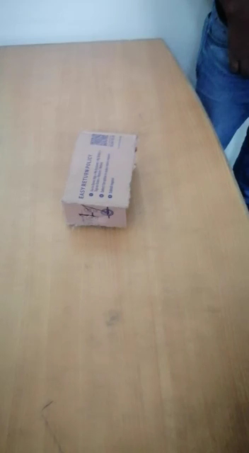
ELECTRIC CAR

Slide 7
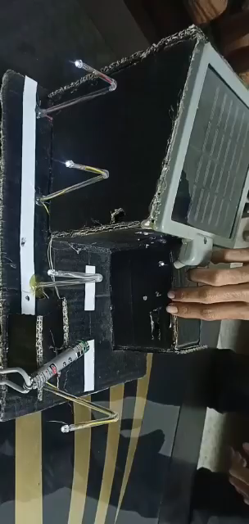
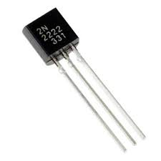
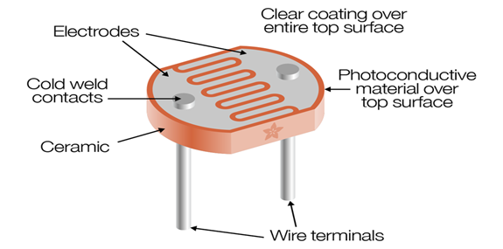
light dependent resistance base House Hold Electric Circuit

Slide 8
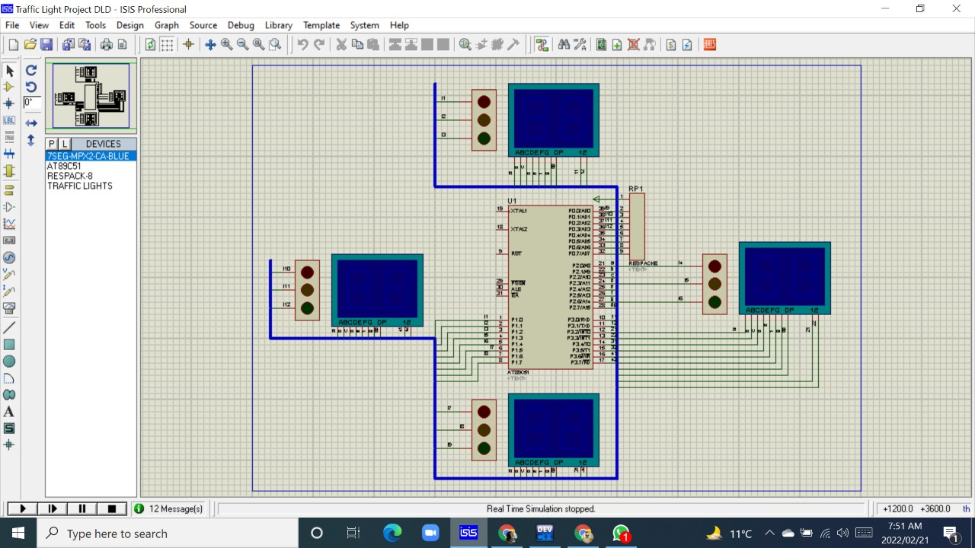
Traffic Lights Programmed Based circuit design on proteus

Slide 9

Traffic Lights Programmed Based circuit design on proteus

